Slide 1
Quantitative Ability

Slide 2
Time and Work

Slide 3
^{TIME & WORK}
Work with different efficiencies
^{Pipes and Cisterns}
^{Work Equivalence}
^{Division of Wages}

Slide 4
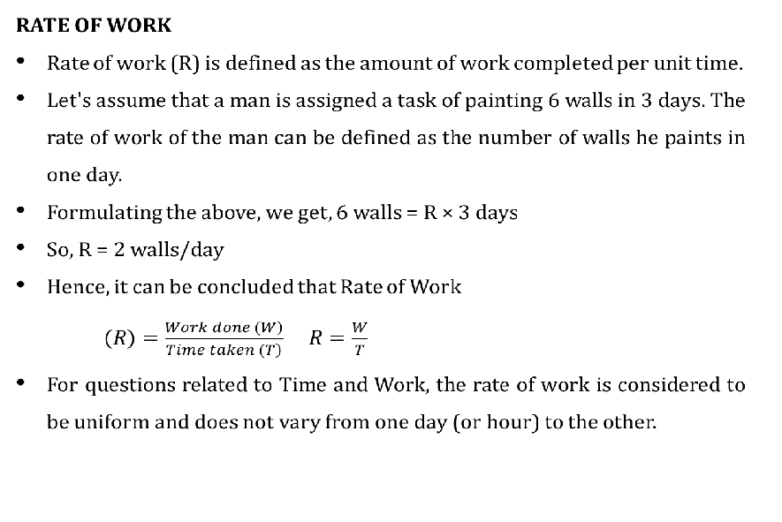
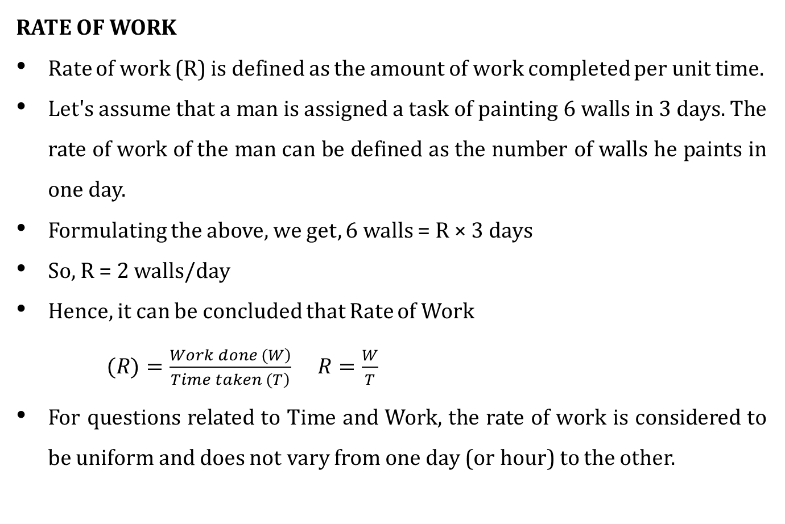

Slide 5
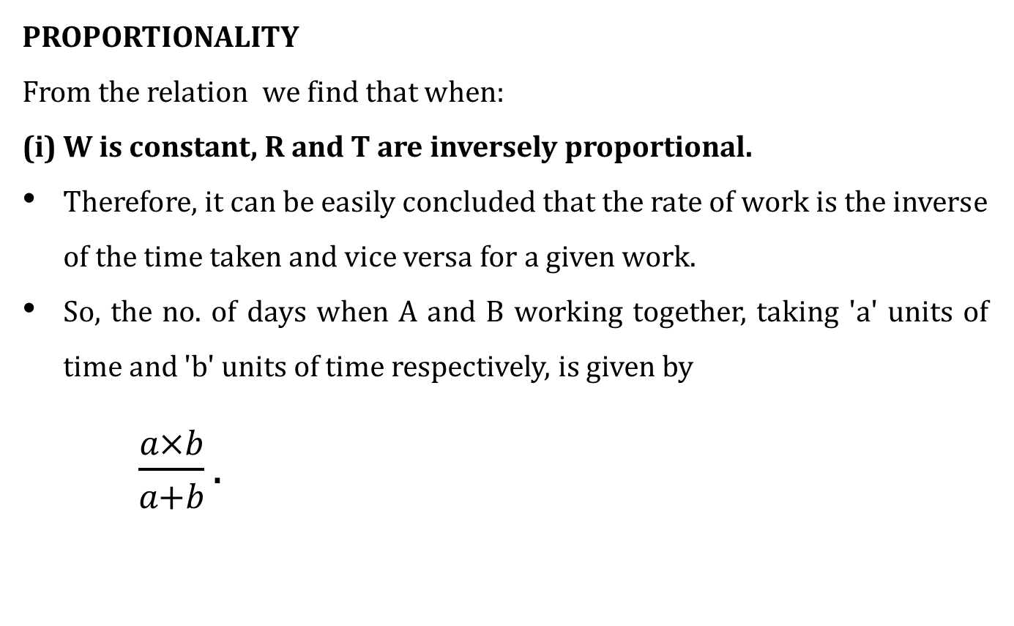
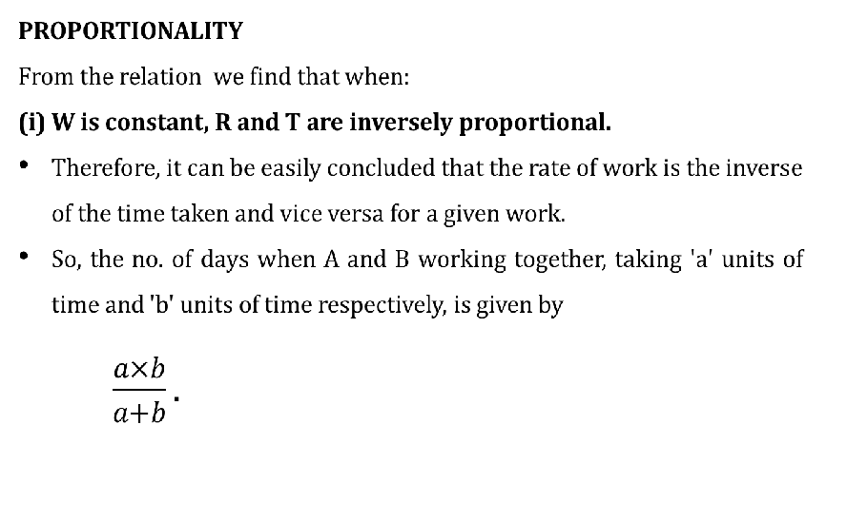

Slide 6
Different types of Questions in Time and Work :
Questions are based on two types generally
^{Same Efficiency}
^{Different Efficiency}
Now let us see the scenarios that are there in these types
^{Under Same Efficiency :}
^{Working Together}
^{Working Alternatively}
^{Pattern Basis}
^{People Quitting and Joining}

Slide 7
^{Negative Work}
^{Pipes and Cisterns}
Scenarios under Same Efficiency
Problems related to Men Day Concept

Slide 8
1. Tony Stark can create an Arc reactor in 15 days whereas Bruce Banner can do the same in 20 days. If both of them join hands in creating the reactor, then how many days would they require to complete the task ?
^{a) 7 days}
^{b) 8 days}
^{c) 7 4/7 days}
^{d) 8 4/7 days}

Slide 9
2. Captain America can destroy a Chitauri in 10 minutes whereas Thor can destroy the same in 15 minutes. If they fight side by side alternatively how long will it take to destroy 2 Chitauris ?
a) 12 minutes
b) 24 minutes
c) 36 minutes
d) 48 minutes

Slide 10
3. Vijay can complete a movie in 18 days and Ajith can do the same work in half the time taken by Vijay to complete a movie. If both Vijay and Ajith are working together, what part of of the movie they can finish in a day ?
a) 1/9
b) 1/18
c) 1/27
d) 1/6

Slide 11
4. Ar Rahman, Anirudh and Santhosh Narayan can finish scoring music for a movie in 24, 6 and 12 days respectively. Working together, they will complete scoring music for a movie in how many days ?
a) 1/24 day
b) 4 days
c) 3.5 days
d) 3 3/7 days

Slide 12
5. Dhanush and Simbu can complete a work in 15 days and 10 days respectively. They started doing the work together but after 2 days Simbu had to leave and Dhanush alone completed the remaining work. The whole work was completed in:
a) 8 days
b) 10 days
c) 12 days
d) 15 days
Notes:
6. Ans: [a]
5 is factor of 16 – 1, therefore it is similar to 3 or 9 divisibility rules of decimal system.
As 1 + 3 + 5 + 6 + 7 + 8 = 30, it is divisible by 5.

Slide 13
6. A can finish a work in 24 days, B in 9 days and C in 12 days. B and
C start the work but are forced to leave after 3 days. The remaining work was done by A in
a) 5 days
b) 6 days
c) 10 days
d) 10 1/2 days

Slide 14
7. A Printing machine P can print one lakh books in 8 hours, machine Q can print the same number of books in 10 hours while machine R can print them in 12 hours. All the machines are started at 9 a.m. while machine P is closed at 11 a.m. and the remaining two machines complete the work. Approximately at what time will the work be finished?
a) 11:30 a.m. b) 12 noon
c) 2 p.m. d) 1 p.m

Slide 15
8. A and B can together finish a work in 30 days. They worked together for 20 days and then B left. After another 20 days, A finished the remaining work. In how many days A alone can finish the job?
a) 40
b) 50
c) 54
d) 60

Slide 16
9. A does 4/5th of a work in 20 days. He then calls in B and they together finish the remaining work in 3 days. How long B alone would take to do the whole work?
a) 23 days
b) 37 days
c) 37 1/2days
d) 40 days

Slide 17
10. A and B together can do a work in 12 days, B and C can do together in 6 days while C and A together can do in 10 days. In how many days C alone will complete the work ?
a) 12 4/5 days
b) 10 10/11 days
c) 14 5/6 days
d) 11 days

Slide 18
11. A and B together can do a work in 12 days, while B and C can do a work in 16 days. After A did it for 5 days and B did it for 7 days, C completed it in 13 days . In how many days can B complete the work ?
a) 24 days
b) 12 days
c) 48 days
d) 60 days

Slide 19
12. A can do a piece of work in 21 days. B is 40 percent more efficient
than A. Then in how many days the work gets completed when both are
working simultaneously?
a) 10 days
b) 12 days
c) 8 3/4 days
d) 9 1/2 days

Slide 20
13. A alone can do a piece of work in 6 days and B alone in 8 days. A
and B undertook to do it for Rs. 3200. With the help of C, they completed the work in 3 days. How much is to be paid to C?
a) Rs 200
b) Rs 300
c) Rs 400
d) Rs 800

Slide 21
15. A's work capacity is 20 % more than B's work capacity. B can complete a task X in 36 days. B and C start doing X work together for 10 days and A alone does the remaining work in 15 days. After which A, B and C work together to complete 1/3 of the work X and then A and C are replaced by D. Now B and D together complete the remaining part of work X in 12 days. D alone can complete the work in ?
a) 36 days b) 45 days
c) 30 days d) 24 days

Slide 22
14. P, Q, R are paid Rs 12000 for doing a work. P and Q start the work and work for 10 days. After that P quits while, R joins Q and they complete the remaining work. How much does Q receive for his work, given that P, Q and R can finish the work in 30, 60 and 90 days respectively ?
a) 6400
b) 5600
c) 4800
d) 6200

Slide 23
Pipes and Cisterns

Slide 24
A pipe is connected to a tank or cistern. It is used to fill or empty the tank; accordingly, it is called an inlet or an outlet.
Inlet : A pipe which is connected to fill a tank is known as an inlet.
Outlet : A pipe which is connected to empty a tank is known as an outlet.
Problems on pipes and cisterns are similar to problems on time and work. In pipes and cistern problems, the amount of work done is the part of the tank of filled or emptied. And, the time taken to do a piece of work is the time take to fill or empty a tank completely or to a desired level.

Slide 25
16. Two Pipes A and B can fill a Cistern in 20 minutes and 30 minutes seperately. If both the pipes are opened together how much long would it take to fill 2/3rd of the tank ?
a) 12 minutes
b) 10 minutes
c) 8 minutes
d) 6 minutes

Slide 26
17. Pipe A and B can fill a cistern in 10 hours and 15 hours respectively. When a third pipe C which works as an outlet pipe is also open then the
cistern can be filled in 18 hours. The outlet pipe can empty a full cistern in:
a) 12 hours
b) 11 hours
c) 10 hours
d) 9 hours

Slide 27
18. Tap A fills a tank in 10 hours and B can fill it in 15 hours. Both are opened simultaneously. Sometimes later tap B was closed, then it takes total 8 hours to fill up the whole tank. After how many hours B was closed?
a) 3
b) 5
c) 6
d) 2

Slide 28
19. Pipe A can fill an empty tank in 30 hours while B can fill it 45 hours. Pipe A and B are opened and closed alternatively i.e., first pipe A is opened, then B, again A and then B and so on for 1 hour each time without any time lapse. In how many hours the tank will be 88 8/9 % filled when it was empty, initially?
a) 32
b) 36
c) 16
d) 18

Slide 29
20. Pipe A can empty a tank in 6 hours. Pipe B alone fill the empty tank at the rate of 4 litres a minute. When the tank is full, both the pipes are opened together and they empty a tank in 8 hours. Find the capacity of the tank
a) 5790 litres
b) 5780 litres
c) 5760 litres
d) 5750 litres

Slide 30
Men - Day Concept (Chain Rule)

Slide 31
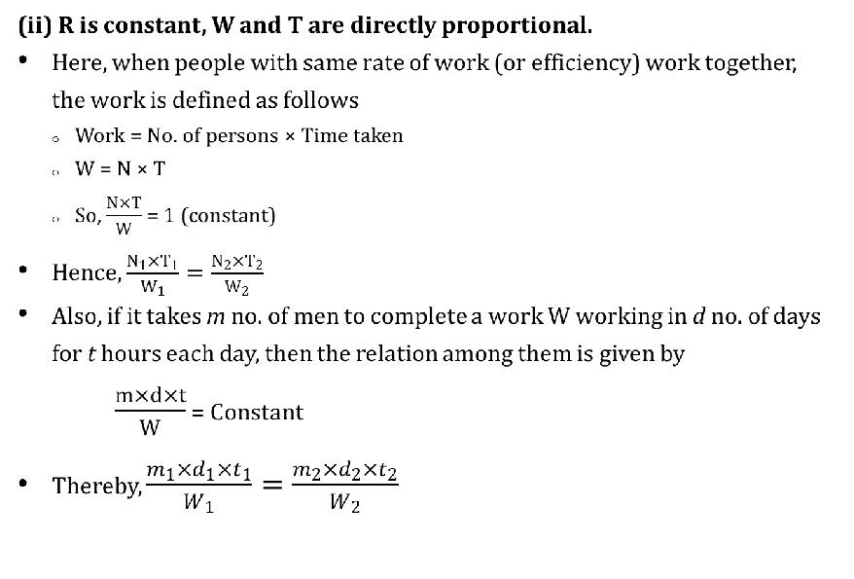
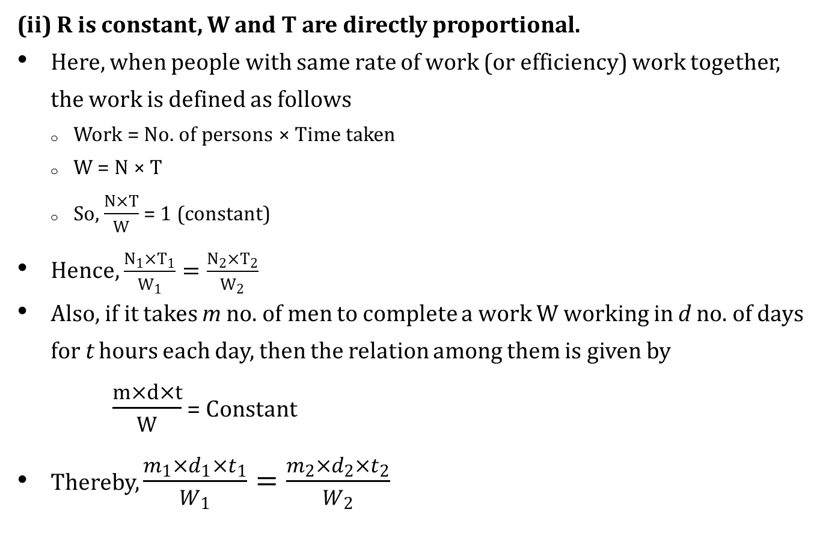

Slide 32
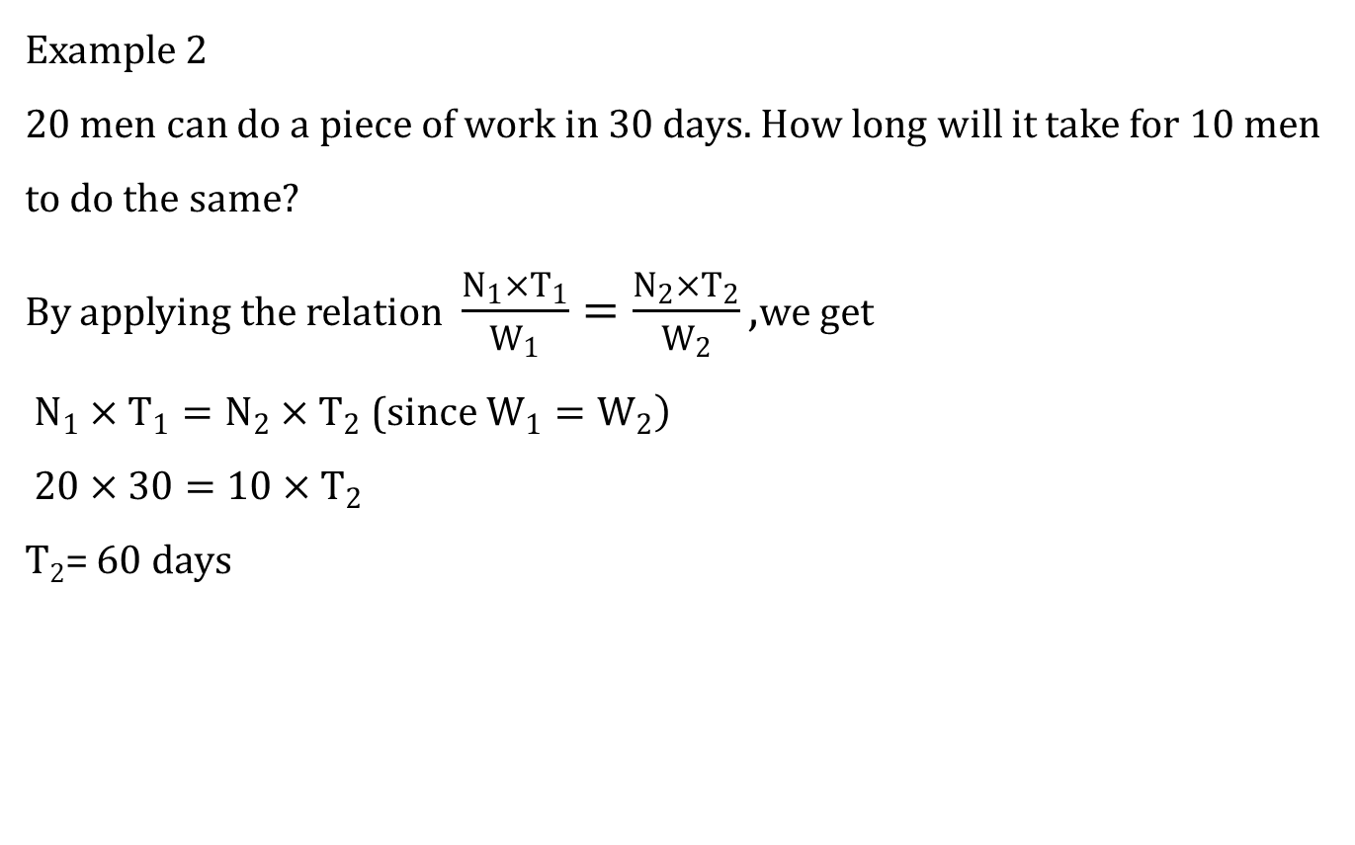
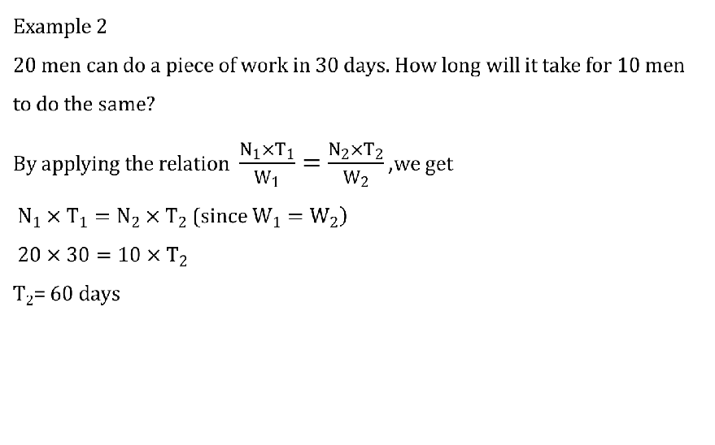

Slide 33
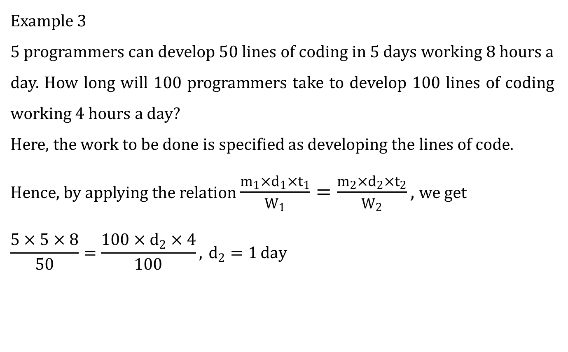
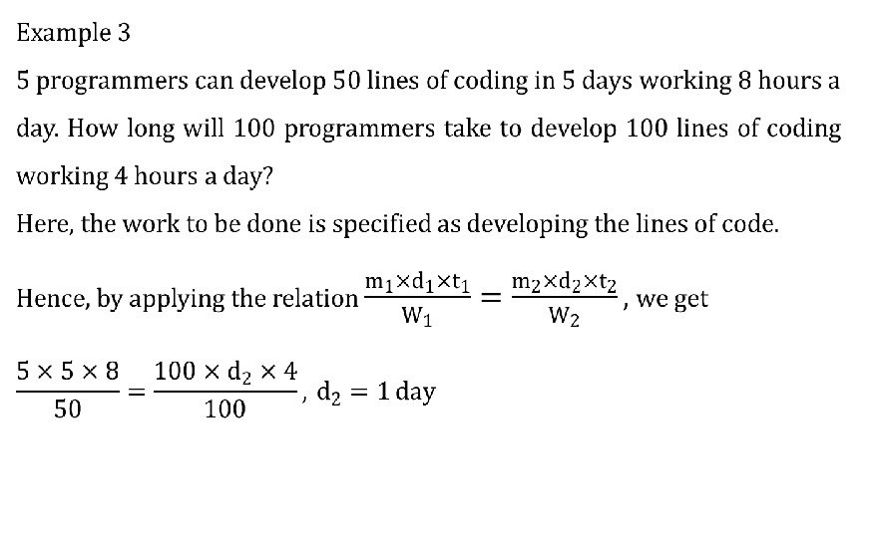

Slide 34
26. 20 elephants can finish 120 kg of sugarcane in 15 days. How long will it take for 30 elephants to finish 240 kg of sugarcane?
(a) 15 days
(b) 18 days
(c) 20 days
(d) 16 days

Slide 35
27. 12 men can complete a piece of work in 9 days. After 3 days of the start of the work, six men joined the team to replace the 2 men who left. How many days will be required to complete the remaining work?
a) 4
b) 4.5
c) 7
d) 6

Slide 36
28. Three men A, B and C are constructing a wall as follows: On the 1st day A builds 3 feet of the wall, 2nd day B builds 2 feet of the wall, but on the 3rd day C breaks 4 feet of the wall. If they work continuously in the same sequence, in how many days will they be able to make a 10 foot wall?
a) 10
b) 30
c) 17
d) 22

Slide 37
29. Challenge Question :
A Frog needs to climb a bore well of height 120 ft for survival. It follows a series of pattern to reach the top of the well i.e in the first minute it climbs 4 ft, in the second minute it climbs 3ft and in the third minute it retards 2 ft and the series continues. Calculate how much time it takes to climb or cross 120 ft ?

Slide 38
30. If 8 men can reap 80 hectares in 24 days, how many hectares can 36 men reap in 30 days?
a) 450
b) 400
c) 300
d) None of these

